Slide 1
Reproducible Research Journal Club
Reproducible Research for Large-Scale Data Analysis
8/3/2016
Contents from Implementing Reproducible Research and Wikipedia

Slide 2
Literate Programing (LP)
An approach to programming introduced by Donald Knuth.
Written as an uninterrupted exposition of logic in an ordinary human language, much like the text of an essay, in which macros are included to hide abstractions and traditional source code.
Literate programming tools are used to obtain two representations from a literate source file:
"tangled" code - for further compilation or execution by a computer;
"woven" document - for viewing as formatted documentation.

Slide 3
Literate Statistical Analysis (LSA)
Derived from Literate Programming
Documentation for data management and statistical analysis as the code for it is produced. All code and documentation is interweaved into each literate document.
The main focus is the whole statistical analysis, not the computational and mathematical implementations as with LP.
The resulting document should provide a clear description of the following:
the origin of the data
the employed statistical methods with caveats and assumptions
the code and programs used
the results of the analysis and their interpretation

Slide 4
Reproducible research in traditional data analysis
Typically 1-2 data analysts and 1-2 clients
Simple idea: adhere to an evolving LSA-based scientific technical report, from which all of the communications and deliverables are generated

Slide 5
Large-Scale Data Analysis
Complex: big data of different types
Computationally and memory intensive analysis methods
Multi-year
Multi-client/stakeholder
Multi-analyst (with diverse background)
Multiple interim result reports
Multiple reporting needs (presentations/communications to team members, to senior management teams, to internal/external journals and conferences, etc)

Slide 6
Drawbacks of LSA in Large-Scale Data Analysis

Slide 7
Multiple Reports and Presentations
In the spirit of LSA, all of the reports and presentations should be generated using the same source document.
But, they will have different formatting, literary style, and amount of information included. They are so different that they have to be written separately.
Then, how should the codes be kept close to all figures and tables they generated in multiple documents? How can you ensure the same code chunks will be synced in all documents?
Notes:
Variety of LSA tools exist, but they will all have similar drawbacks when dealing with large scale data analysis.

Slide 8
Execution of Code
LSA tools are set up to tangle out the code then execute all code blocks in a documents every time the document is being exported into a pdf.
BUT, for computationally intensive projects, this can take many days. Caching of results and executing code chunks only if changes have occurred can solve this issue.
HOWEVER, problem still exists when it comes to complex dependency structures between code chunks, displays, and changes in the input data.
Solution: include a make-file that controls the execution of the various code blocks, knows about the dependencies between the code chunks and the underlying data, and only re-execute those code parts where truly something has changed.
Notes:
Variety of LSA tools exist, but they will all have similar drawbacks when dealing with large scale data analysis.

Slide 9
Cooperation with Other Team Members
When reports are sent to other team members for review, changes made to reports does not change the source code.
Solution: analysts have to make all changes based on comments from other team members in the source code. This is not only time consuming, but also easy to lose track of who the comments originated from.
Notes:
Variety of LSA tools exist, but they will all have similar drawbacks when dealing with large scale data analysis.

Slide 10
Adapted Implementations (closer to traditional programming practice with some aspects of LSA incorporated)

Slide 11
Split the code from the final report and have one org-document with the code of the project (using different level headings to structure the analysis into logical parts) and a separate document with the final report.
Each code chunk should either be a function (written in abstract form and loaded as a library) or be self-contained (all necessary data are loaded in the beginning and results written out in the end).
Each self-contained code chunk should be tangled out into a separate file.
Before each code chunk, a short description of the task to be done should be provided.
Code execution using makefiles.
Use version control system (git) to manage changes to the code or final report, and data (with git-annex due to large size)
Ensure future availability of software (for examples, for R, by storing the source version of packages and documenting the version of R).

Slide 12
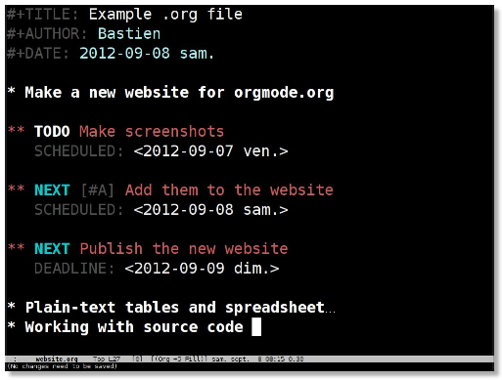
Org mode
for keeping notes, maintaining TODO lists, planning projects, and authoring documents with a fast and effective plain-text system

Slide 13
Improvements for the Future

Slide 14
Microsoft Office
In many fields of academia and even more so outside of academia, Microsoft Word and PowerPoint are the standards for reports and presentations. Useful solution would be tools that can dynamically insert figures and tables into Word or PowerPoint. R package R2wd does this.
Table Support
Unlike graphics, where support for PNG as well as JPEG graphics is relatively universal; for tables, each document format has its own way of describing tables but support between them is rather poor.
Headers and Footers
LSA keeps the output and corresponding code closely associated, but if a figure is copied from one presentation to the next, the link is broken. A very simple method of addressing this is to put a header and footer on each document that specifies the source code file that produced it and other information such as research program and data. SAS has very good support for these concepts, but R does not.

Slide 15
Alternatives to LP/LSA

Slide 16
Documentation generators (DGs)
Provide automatic tools to extract comments from the source code and collate them into a documentation documents for the software project in various formats such as HTML and pdf.
Available for many programming languages.
However, the documentation is not in the format of a normal analysis report nor does it contain any results of the analysis. Therefore the final report has to be written separately.
Do not provide for a direct way to order the source code of separate files into a logical ordering.

